Slide 1


CSE332: Data Abstractions
Section 7
HyeIn Kim
Winter 2013

Slide 2
Section Agenda
Graph Review
- Graph Terminologies
- Graph Representations: matrix & list
- Topological sort
- Graph traversal: BFS, DFS
- Shortest Path: Dijkstra’s Algorithm
Project 3 Introduction
- Analyzing US census data

Slide 3
Graphs
Graph terminology

Slide 4
Graphs
G = (V, E)
Contains set of vertices and set of edges
- | V | = number of vertices
- | E | = number of edges
Max | E | for undirected graph
Max | E | for directed graph
|V| + (|V| - 1) + (|V| - 2) + ... + 1 = |V|(|V| + 1) / 2
|V| + |V| + |V| + ... + |V| = |V|* |V| = |V|²

Slide 5
Graph Terms
Path
List of vertices [v₀, v₁, ..., v_{n}], such that
(v_{i}, v_{i+1}) ∈ E for all 0 ≤ i < n
- Path length =
- Path cost =
Cycle
number of edges on path
sum of all edge weights on path
A path that begins and ends at the same node

Slide 6
Undirected Graph
Edges have no directions
Connected
Fully Connected
If there is a path between all pairs of vertices
If there is an edge between all pairs of vertices

Slide 7
Directed Graph
Edges have direction
Weakly Connected
Strongly Connected
Fully Connected
If there is an undirected path between all pairs of vertices
If there is a directed path between all pairs of vertices
If there is edge (both way) between all pairs of vertices

Slide 8
Graph Representation
Adjacency matrix & Adjacency list

Slide 9
Graph Representation
The ‘Best one’ depends on:
- Graph density
- Common Queries
Insert an edge
Delete an edge
Find an edge
Compute indegree of a vertex
Compute outdegree of a vertex

Slide 10
Adjacency Matrix
f\t | a | b | c | d | e | f | g | h | i
a |  | 1 | 1 | 1 | 1
b |  |  | 1
c |  |  |  |  | 1 |  | 1
d |  |  | 1 |  |  | 1
e |  |  |  |  |  |  |  | 1
f |  |  |  |  |  |  |  |  | 1
g |  |  |  |  |  | 1 |  |  | 1
h |  |  |  |  |  |  | 1 |  | 1
i
a
d
b
c
g
f
e
i
h
Space Requirement:
| V |²

Slide 11
Adjacency Matrix
f\t | a | b | c | d | e | f | g | h | i
a |  | 1 | 1 | 1 | 1
b |  |  | 1
c |  |  |  |  | 1 |  | 1
d |  |  | 1 |  |  | 1
e |  |  |  |  |  |  |  | 1
f |  |  |  |  |  |  |  |  | 1
g |  |  |  |  |  | 1 |  |  | 1
h |  |  |  |  |  |  | 1 |  | 1
i
Get indegree:
O(|V|)
Get outdegree:
O(|V|)
Find an edge:
O(1)
Insert an edge:
O(1)
Delete an edge:
O(1)
- Dense graph |E| >>> |V|, so good for dense graph

Slide 12
Adjacency List
a | b | c | d | e
b | c
c | e | g
d | c | f
e | h
f | i
g | f | i
h | g | i
i
a
d
b
c
g
f
e
i
h
Space Requirement:
O(|V| + |E|)

Slide 13
Adjacency List
- Let d = outdegree
a | b | c | d | e
b | c
c | e | g
d | c | f
e | h
f | i
g | f | i
h | g | i
i
Get indegree:
O(|V|+|E|)
Get outdegree:
O(d), O(1) possible
Find an edge:
O(d)
Insert an edge:
O(1)
Delete an edge:
O(d)
- Sparse graph |V| >>> d, so good for sparse graph

Slide 14
Topological Sort
Get linear order of tasks
with dependencies

Slide 15
Topological Sort
Given a set of tasks with precedence constraints,
find a linear order of the tasks
- No topological ordering in graph with cycle
- Possible to have many topological ordering
A
F
E
A
D
B
E
C
F
B
C
D

Slide 16
Topological Sort
Topological sort algorithm
- Choose a vertex v with indegree 0
- Output v & Remove v and all of its edges
- Repeat until no more vertices left
E
E
A
D
D
C
C
F
F
B
B

Slide 17
Topological Sort
E
E
E
D
D
D
C
B
F
F
F
B
D
A C B E D F
F
F

Slide 18
Topological Sort
Topological sort Runtime
- Choose a vertex v with indegree 0
- Output v & Remove v
- Remove all of v’s edges
Total Runtime:
Single step (No Q / Q):
O(|V|)
O(1)
Total (No Q / Q):
O(|V|²)
O(|V|)
Total:
O(|V|)
Total:
O(|E|)
O(|V|²+|E|) No Queue
O(|V|+|E|) Queue

Slide 19
Graph Traversal
BFS & DFS

Slide 20
Breadth First Search
Pick the shallowest unmarked node
- Use queue, new node go to the end
A
Start with the root in the queue
B
C
Queue | A
D
E
F
G
A
Pop one out, mark it,
put its child into the queue
B
C
Queue | B | C
D
E
F
G

Slide 21
Breadth First Search
Pick the shallowest unmarked node
- Use queue, new node go to the end
A
Pop one out, mark it,
put its child into the queue
B
C
Queue | C | D | E
D
E
F
G
A
Pop one out, mark it,
put its child into the queue
B
C
Queue | D | E | F | G
D
E
F
G

Slide 22
Breadth First Search
Pick the shallowest unmarked node
- Use queue, new node go to the end
A
Pop one out, mark it,
put its child into the queue
B
C
Queue | E | F | G
D
E
F
G
A
Pop one out, mark it,
put its child into the queue
B
C
Queue | F | G
D
E
F
G

Slide 23
Breadth First Search
Pick the shallowest unmarked node
- Use queue, new node go to the end
A
Pop one out, mark it,
put its child into the queue
B
C
Queue | G
D
E
F
G
A
Pop one out, mark it,
put its child into the queue
B
C
Queue
D
E
F
G

Slide 24
Breadth First Search
Pick the shallowest unmarked node
- Use queue, new node go to the end
A
The queue is empty, Done!
B
C
Queue
D
E
F
G
- The order of traversal: A B C D E F G
- Let b = branching factor, h = height
Space requirement:
O(b^{h})

Slide 25
Depth First Search
Pick the deepest unmarked node
- Use stack, new node go to the top
A
Start with the root in the stack
B
C
Stack | A
D
E
F
G
A
Pop one out, mark it,
put its child into the stack
B
C
Stack | B | C
D
E
F
G

Slide 26
Depth First Search
Pick the deepest unmarked node
- Use stack, new node go to the top
A
Pop one out, mark it,
put its child into the stack
B
C
Stack | B | F | G
D
E
F
G
A
Pop one out, mark it,
put its child into the stack
B
C
D
E
F
G
Stack | B | F

Slide 27
Depth First Search
Pick the deepest unmarked node
- Use stack, new node go to the top
A
Pop one out, mark it,
put its child into the stack
B
C
Stack | B
D
E
F
G
A
Pop one out, mark it,
put its child into the stack
B
C
D
E
F
G
Stack | D | E

Slide 28
Depth First Search
Pick the deepest unmarked node
- Use stack, new node go to the top
A
Pop one out, mark it,
put its child into the stack
B
C
Stack | D
D
E
F
G
A
Pop one out, mark it,
put its child into the stack
B
C
Stack
D
E
F
G

Slide 29
Depth First Search
Pick the deepest unmarked node
- Use stack, new node go to the top
A
The stack is empty, Done!
B
C
Stack
D
E
F
G
- The order of traversal: A C G F B E D
- Let b = branching factor, h = height
Space requirement:
O(b*h)

Slide 30
Find Shortest Path
Dijkstra’s Algorithm

Slide 31
Dijkstra’s Algorithm
Source Node: A
Pick one with shortest distance from source:
A
4
3
a
b
c
Node | Mark | Dist | Path | Mark | Dist | Path
A |  | 0
B |  | ∞
C |  | ∞ |  |  | ∞
D |  | ∞
E |  | ∞
F |  | ∞ |  |  | ∞
G |  | ∞ |  |  | ∞
H |  | ∞ |  |  | ∞
I |  | ∞ |  |  | ∞
1
0
-
1
12
4
A
10
11
4
7
8
d
e
f
10
A
5
1
A
6
2
7
3
g
h
I
9
6

Slide 32
Dijkstra’s Algorithm
Source Node: A
Pick one with shortest distance from source:
E
4
3
a
b
c
Node | Mark | Dist | Path | Mark | Dist | Path
A | 1 | 0 | - | 1 | 0 | -
B |  | 4 | A
C |  | ∞
D |  | 10 | A
E |  | 1 | A
F |  | ∞
G |  | ∞
H |  | ∞
I |  | ∞
1
12
4
A
10
11
4
13
E
7
8
d
e
f
8
E
5
1
1
A
6
2
7
3
9
E
6
E
g
h
I
9
6
8
E
3
E

Slide 33
Dijkstra’s Algorithm
Source Node: A
Pick one with shortest distance from source:
I
4
3
a
b
c
Node | Mark | Dist | Path | Mark | Dist | Path
A | 1 | 0 | - | 1 | 0 | -
B |  | 4 | A |  | 4 | A
C |  | 13 | E |  | 13 | E
D |  | 8 | E |  | 8 | E
E | 1 | 1 | A | 1 | 1 | A
F |  | 9 | E
G |  | 6 | E |  | 6 | E
H |  | 8 | E
I |  | 3 | E
1
12
10
11
4
7
8
d
e
f
5
2
6
7
3
6
I
g
h
I
9
6
8
E
1
3
E

Slide 34
Dijkstra’s Algorithm
Source Node: A
Pick one with shortest distance from source:
B
4
3
a
b
c
Node | Mark | Dist | Path | Mark | Dist | Path
A | 1 | 0 | - | 1 | 0 | -
B |  | 4 | A
C |  | 13 | E
D |  | 8 | E |  | 8 | E
E | 1 | 1 | A | 1 | 1 | A
F |  | 6 | I |  | 6 | I
G |  | 6 | E |  | 6 | E
H |  | 8 | E |  | 8 | E
I | 1 | 3 | E | 1 | 3 | E
1
12
1
4
A
10
11
4
7
B
7
8
d
e
f
5
2
6
7
3
g
h
I
9
6

Slide 35
Dijkstra’s Algorithm
Source Node: A
Pick one with shortest distance from source:
F
4
3
a
b
c
Node | Mark | Dist | Path | Mark | Dist | Path
A | 1 | 0 | - | 1 | 0 | -
B | 1 | 4 | A | 1 | 4 | A
C |  | 7 | B
D |  | 8 | E |  | 8 | E
E | 1 | 1 | A | 1 | 1 | A
F |  | 6 | I
G |  | 6 | E |  | 6 | E
H |  | 8 | E |  | 8 | E
I | 1 | 3 | E | 1 | 3 | E
1
12
10
11
4
7
B
7
8
d
e
f
5
2
6
7
3
1
6
I
g
h
I
9
6

Slide 36
Dijkstra’s Algorithm
Source Node: A
Pick one with shortest distance from source:
G
4
3
a
b
c
Node | Mark | Dist | Path | Mark | Dist | Path
A | 1 | 0 | - | 1 | 0 | -
B | 1 | 4 | A | 1 | 4 | A
C |  | 7 | B |  | 7 | B
D |  | 8 | E
E | 1 | 1 | A | 1 | 1 | A
F | 1 | 6 | I | 1 | 6 | I
G |  | 6 | E
H |  | 8 | E
I | 1 | 3 | E | 1 | 3 | E
1
12
10
11
4
7
8
d
e
f
8
E
5
2
6
7
3
1
6
E
g
h
I
9
6
8
E

Slide 37
Dijkstra’s Algorithm
Source Node: A
Pick one with shortest distance from source:
C
4
3
a
b
c
Node | Mark | Dist | Path | Mark | Dist | Path
A | 1 | 0 | - | 1 | 0 | -
B | 1 | 4 | A | 1 | 4 | A
C |  | 7 | B
D |  | 8 | E |  | 8 | E
E | 1 | 1 | A | 1 | 1 | A
F | 1 | 6 | I | 1 | 6 | I
G | 1 | 6 | E | 1 | 6 | E
H |  | 8 | E |  | 8 | E
I | 1 | 3 | E | 1 | 3 | E
1
12
10
11
4
1
7
B
7
8
d
e
f
5
2
6
7
3
g
h
I
9
6

Slide 38
Dijkstra’s Algorithm
Source Node: A
Pick one with shortest distance from source:
D
4
3
a
b
c
Node | Mark | Dist | Path | Mark | Dist | Path
A | 1 | 0 | - | 1 | 0 | -
B | 1 | 4 | A | 1 | 4 | A
C | 1 | 7 | B | 1 | 7 | B
D |  | 8 | E
E | 1 | 1 | A | 1 | 1 | A
F | 1 | 6 | I | 1 | 6 | I
G | 1 | 6 | E | 1 | 6 | E
H |  | 8 | E
I | 1 | 3 | E | 1 | 3 | E
1
12
10
11
4
7
8
d
e
f
1
8
E
5
2
6
7
3
g
h
I
9
6
8
E

Slide 39
Dijkstra’s Algorithm
Source Node: A
Pick one with shortest distance from source:
H
4
3
a
b
c
Node | Mark | Dist | Path | Mark | Dist | Path
A | 1 | 0 | - | 1 | 0 | -
B | 1 | 4 | A | 1 | 4 | A
C | 1 | 7 | B | 1 | 7 | B
D | 1 | 8 | E | 1 | 8 | E
E | 1 | 1 | A | 1 | 1 | A
F | 1 | 6 | I | 1 | 6 | I
G | 1 | 6 | E | 1 | 6 | E
H |  | 8 | E
I | 1 | 3 | E | 1 | 3 | E
1
12
10
11
4
7
8
d
e
f
5
2
6
7
3
g
h
I
1
8
9
6
E

Slide 40
Dijkstra’s Algorithm
Source Node: A
Done!
4
3
a
b
c
Node | Mark | Dist | Path
A | 1 | 0 | -
B | 1 | 4 | A
C | 1 | 7 | B
D | 1 | 8 | E
E | 1 | 1 | A
F | 1 | 6 | I
G | 1 | 6 | E
H | 1 | 8 | E
I | 1 | 3 | E
1
12
10
11
4
7
8
d
e
f
5
2
6
7
3
g
h
I
9
6

Slide 41
Dijkstra’s Algorithm
Source Node: A
Find shortest path from F to A
4
3
a
b
c
Node | Mark | Dist | Path
A | 1 | 0 | -
B | 1 | 4 | A
C | 1 | 7 | B
D | 1 | 8 | E
E | 1 | 1 | A
F | 1 | 6 | I
G | 1 | 6 | E
H | 1 | 8 | E
I | 1 | 3 | E
1
12
10
11
4
7
8
d
e
f
5
2
6
7
3
g
h
I
9
6

Slide 42
Dijkstra’s Algorithm
Dijkstra’s Algorithm Runtime
- Initializing each node
- Pick smallest v & Mark v
- Update cost of all
neighbors of v
Total Runtime:
O(|V|)
Single step (No PQ / PQ):
O(|V|)
O(log |V|)
Total (No Q / Q):
O(|V|²)
O(|V|*log|V|)
Total (No PQ):
O(|E|)
Total (PQ):
O(|E|*log|V|)
O(|V|²+|E|) No Priority Queue
O((|V|+|E|)*log|v|) Priority Queue

Slide 43
Dijkstra’s Algorithm
Total Runtime:
- Sparse graph: |V| >>> |E|, O(|V|*log|V|)
- Dense graph: |E| >>> |V|, O(|E|*log|V|)
O(|V|²+|E|) No Priority Queue
O((|V|+|E|)*log|v|) Priority Queue
Better with Priority Queue
=> O(|V|²*log|V|)
Better without Priority Queue

Slide 44
Project 3
Where are the people?

Slide 45
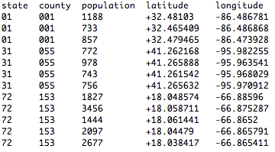
Project 3
US Census Bureau
Treat towns as points

Slide 46
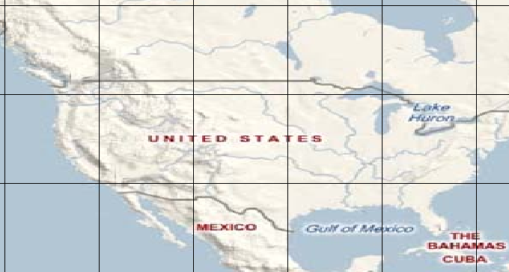
Project 3
US Census Bureau
1. Divide US with X by Y Grid
2. Compute Population in selected Rectangle

Slide 47
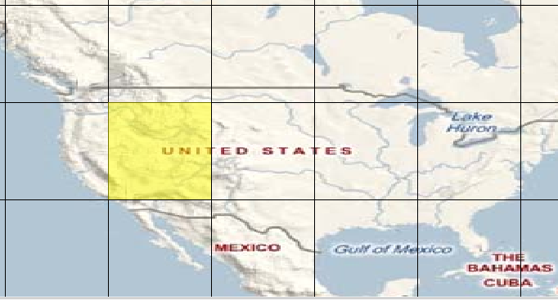
Project 3
US Census Bureau
Population: 26360678
Percentage of total US: 9.24%

Slide 48
Project 3
Five different implementation
1. Simple & Sequential
2. Simple & Parallel
3. Smarter & Sequential
4. Smarter & Parallel
5. Smarter & Lock-Based
Experiments & Write up
- Compare 5 versions with different queries
Phase A
Phase B
Phase C

